Slide 1
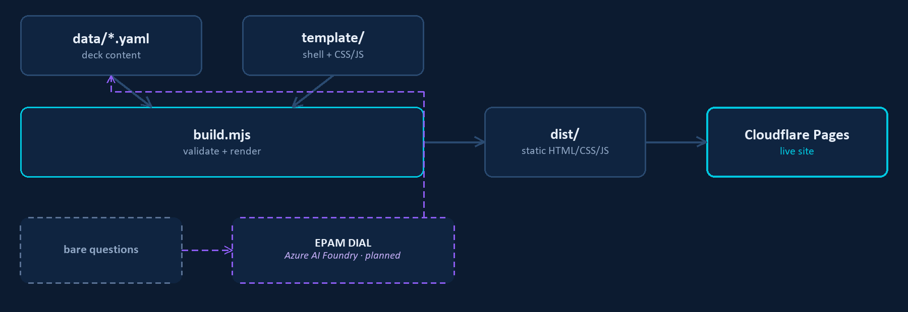
AI UPSKILL · MAY 2026
3-WEEK INITIATIVE
INTERACTIVE LEARNING SITE GENERATOR
TEAM
INTRODUCTION
OTHERS
Łukasz Kwaśniewski
Student
A static-site generator for the AI Upskill initiative: structured Q&A decks become a fast, interactive, self-quizzing site. The first deck — 44 AI-engineering interview questions — proves the pipeline end to end.
IMPACT
Working PoC verified end-to-end in a real browser: search, filters, expand/collapse, confidence tracking and theme toggle all match the original exactly. A new topic is now one YAML file, not a new page.
SOLUTION
TECH STACK
LEARNINGS
Node.js
Cloudflare
GitHub
Reading the actual script mattered: the confidence tracker was never persisted — an earlier assumption was wrong. EPAM DIAL exposes an Azure-OpenAI-shaped API, the concrete link to Azure AI Foundry.
Claude Code
js-yaml
cheerio
EPAM DIAL
NEXT STEPS
Publish: public GitHub repo, Cloudflare Pages project, first live deploy. Wire answer generation to an EPAM DIAL endpoint for future bare-question decks. Package the publish flow as a reusable Claude Code skill.
BUSINESS CHALLENGES
Node.js build script renders each deck’s YAML through a template lifted from the original prototype’s own CSS/JS — zero framework. A one-time script (cheerio) migrated the first deck from HTML, self-validating question counts against the source. Output is fully static, deployed on Cloudflare Pages. Content fields trust a small set of inline HTML, a deliberate choice since decks are author-written.
Study content trapped in one-off files
New topics mean repetitive manual web work
“Spec-driven” claimed more than proven
No path yet from bare questions to an LLM
ADDITIONAL NOTES
Spec: specs/site-generator/spec.md in-repo. Public repo + live URL added here once published — see the README’s status list for what’s left.
.NET AI UPSKILL INITIATIVE — MAY 2026
CONFIDENTIAL

